Slide 1
CUSTOMER CHURN PREDICTOR FOR SYRIALTEL
Minimizing Churn, Maximizing Value

Slide 2
Business Problem
SyriaTel is experiencing customer churn—when users stop using the service—which leads to significant revenue loss in a competitive telecom market.
This project aims to develop a machine learning classifier that predicts customer churn using historical behavioral and demographic data.
By identifying at-risk customers early, SyriaTel can take proactive measures (e.g. loyalty offers, targeted outreach) to improve retention and revenue stability.
✅ Business Question-Can historical customer data reveal patterns that predict who is likely to churn?
✅ Machine Learning Task-Binary Classification – Predict whether a customer will churn (Yes/No)

Slide 3
Project Objectives
1.Identify the key drivers and patterns that contribute to customer churn
2.Predict churn with a classification model .
3.Provide actionable business insights and interventions.
4.Reduce customer attrition and increase revenue stability.

Slide 4
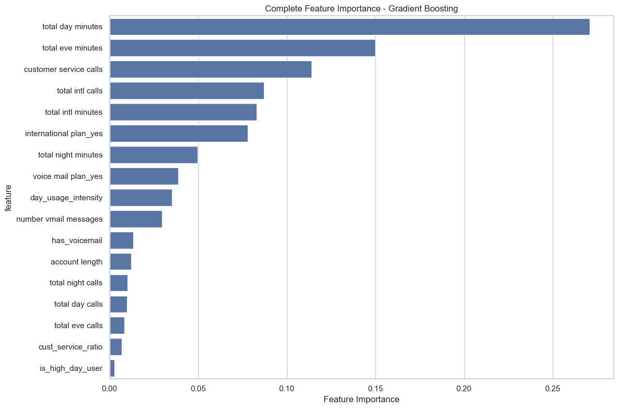
Key features Driving Churn Prediction.

Slide 5
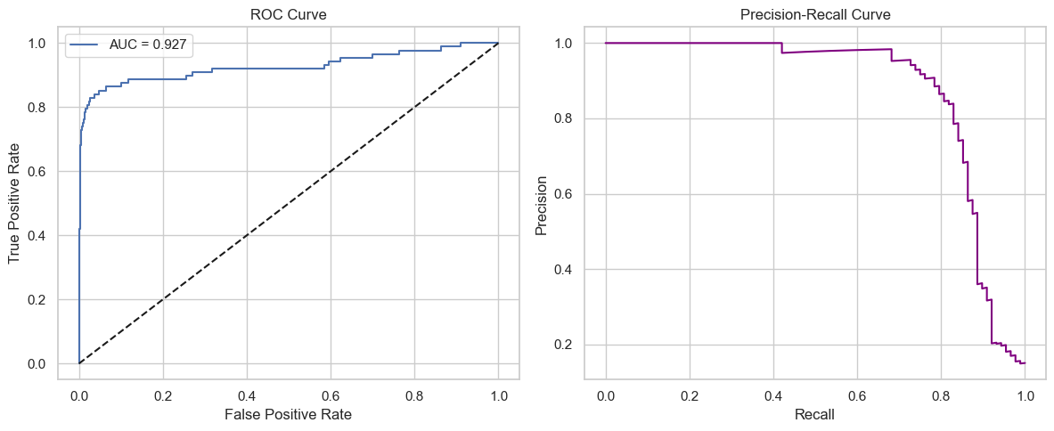
Model’s performance in identifying potential Churners

Slide 6
Interpreting ROC –AUC & precision-recall curve
📈 ROC Curve (Left Chart)
The Good News: Our model dramatically outperforms random guessing
When we need to identify customers at risk, our model gets it right 9 out of 10 times
Business Impact: Minimal wasted effort on customers who aren’t actually at risk
Precision-Recall Curve (Right Chart)
The Good News: When our model flags a customer as “at-risk,” it’s almost always correct- i.e Very few false alarms - we won’t waste time and money on the wrong customers
Business Impact: Focused, efficient use of retention resources

Slide 7
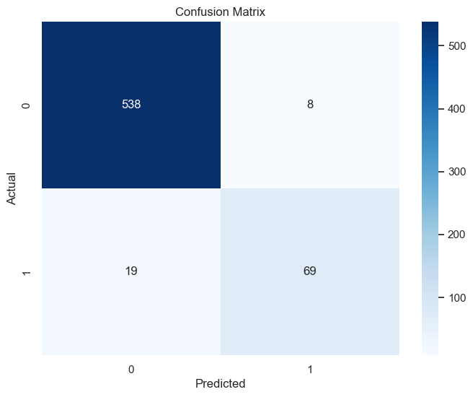
Model’s classification performance

Slide 8
Interpretation of the Confusion matrix
Class 0 (Non-Churners) - Precision- 0.97 - Of all customers predicted not to churn, 97% were correct.
Recall- 0.99- The model correctly identified 99% of actual non-churners.
F1-Score: 0.98 - Indicates excellent overall performance for this majority class.
Class 1(Churners)
Precision: 0.90 - 90% of customers predicted to churn actually did.
Recall: 0.78 -The model successfully detected 78% of true churners.
F1-Score: 0.84 - A solid score showing good balance despite slight under-detection of churners.

Slide 9
Recommendations
1.Revenue Protection Strategy
🔔 Billing-Based Retention-Trigger alerts for customers with high Total Day Minutes-that translate to high day charges. Offer 10–20% discounts to prevent high-value customer churn. Protect revenue by addressing pricing concerns before they escalate.
📞 Customer Service Churn Triggers •🛎️ Flag accounts with multiple recent support calls Escalate early to retention specialists. Treat every service call as a churn prevention opportunity.

Slide 10
Recommendations
2.Operational Excellence
📈 Real-Time Risk Dashboards-Use the model’s near perfect precision to identify real churn threats, Focus retention efforts only where it matters most, Enable confident, efficient interventions.
📩 Voicemail Usage Monitoring- Analyze voicemail behavior to detect dissatisfaction or evolving needs, Proactively resolve network or service issues before they trigger churn.

Slide 11
3.Smart Retention Tactics
🎯 Personalized Retention Tactics-Infrequent users: Offer usage-based plans, High complaint customers: Resolve fast, add goodwill gestures, Loyal but disengaging users: Deploy re-engagement campaigns.
🤖 Automate at Scale- Use churn scores to trigger retention workflows via SMS, email, or push.,Ensure timely, personalized outreach before it’s too late.

